Slide 1
Project Title: Secure Data Hiding Using Steganography and Encryption
CAPSTONE PROJECT
Presented By: Abbas Darbar
Student Name: Abbas Darbar
College Name & Department : RCOEM, Nagpur (CSE)

Slide 2
OUTLINE
Problem Statement
Technology used
Wow factor
End users
Result
Conclusion
Git-hub Link
Future scope

Slide 3
Problem Statement
With rising cybersecurity threats, securing sensitive information is crucial. This project implements LSB steganography with Fernet encryption to embed encrypted messages in images, ensuring data confidentiality. It provides a CLI-based solution for secure message encoding and decoding, preventing unauthorized access.

Slide 4
Technology used
Technologies Used:
Programming Language: Python 3.x
Libraries:
OpenCV (cv2) – Image processing
NumPy – Pixel manipulation
Cryptography (Fernet) – Message encryption & decryption
Platform: Windows/Linux/Mac (Cross-platform)
Execution: Command Line Interface (CLI)

Slide 5
Wow factors
Unique Features:
Steganography with Encryption – Uses LSB steganography with Fernet encryption for added security.
Error Handling & Authentication – Prevents unauthorized decryption with passcode validation.
Cross-Platform Support – Works on Windows, Linux, and Mac.
Efficient & Minimalistic – Lightweight, fast, and requires minimal dependencies.
Inspired by Cutting-Edge Data Hiding – Similar to recent research where data was secretly embedded in YouTube videos, this project explores secure, hidden data storage within images.
This approach enhances covert communication and data security against modern cyber threats.

Slide 6
End users
The end users of this project include:
Cybersecurity Enthusiasts & Students – Learning about steganography and data security.
Ethical Hackers & Security Researchers – Exploring secure data hiding techniques.
Privacy-Conscious Users – Hiding sensitive messages in images.
Forensic Analysts – Investigating steganographic techniques.
Developers & Engineers – Implementing steganography in real-world applications.

Slide 7
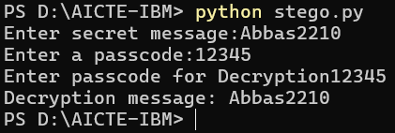
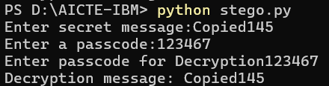
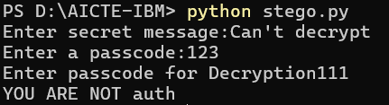
Results
Screenshots of the outcome (min 3)
Success
Success
Failure (Not Authorized)

Slide 8
Conclusion
This project successfully implements LSB steganography to securely hide and retrieve messages in images. By integrating password protection, it adds an extra layer of security to prevent unauthorized access. The project addresses the challenge of secure data hiding by ensuring messages remain undetectable to hackers while being easily retrievable by authorized users.
This method provides a simple yet effective way to protect sensitive information, making it useful for cybersecurity applications, privacy protection, and secure communication. Future improvements could include stronger encryption, adaptive embedding techniques, and support for larger message storage.

Slide 9
GitHub Link
GitHub Link
(Ctrl + Click to follow the link)

Slide 10
Future scope(optional)
This project can be expanded in several ways to enhance security and usability:
🔹 Stronger Encryption – Integrate AES or RSA encryption to further protect hidden messages. 🔹 Adaptive Steganography – Use advanced algorithms to embed data in complex image regions, making detection harder. 🔹 Support for Multiple Image Formats – Extend compatibility beyond PNG and JPG. 🔹 Automated Key Management – Implement a secure key generation and management system. 🔹 Steganalysis Resistance – Improve techniques to avoid detection by steganalysis tools.

Slide 11
THANK YOU

